Slide 1

Java 8 Sharing
1

Slide 2

Agenda
Interface static and default methods Functional paradigm
Lambda expressions Stream API Collectors
Optional
Date and Time API
2

Slide 3

Why you should learn Java 8?
学习函数式编程的理念
Lambdas
Declarative data processing
新的API Date and Time API Stream API Concurrency utilities
干净的API设计
Optional
Interface default and static methods
3

Slide 4
Section 01
Interface API Design
4

Slide 5

Three main components of API Design
Interfaces Abstract Classes Classes
5

Slide 6

Static methods
可以在接口内部定义静态方法
定义静态的接口工具方法
6

Slide 7
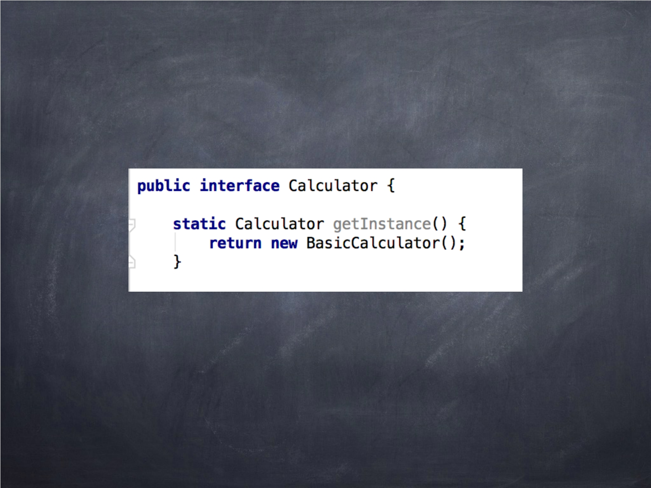
Static method example
7

Slide 8
Interfaces can now have static and default(instance)
methods
8

Slide 9

Why we need this?
随着时间的发展，API易维护易扩展
JDK源码的兼容
9

Slide 10

Default Methods
接口可以支持非抽象方法
随着时间的发展，API易维护易扩展
消除一些不必要的工具类
10

Slide 11
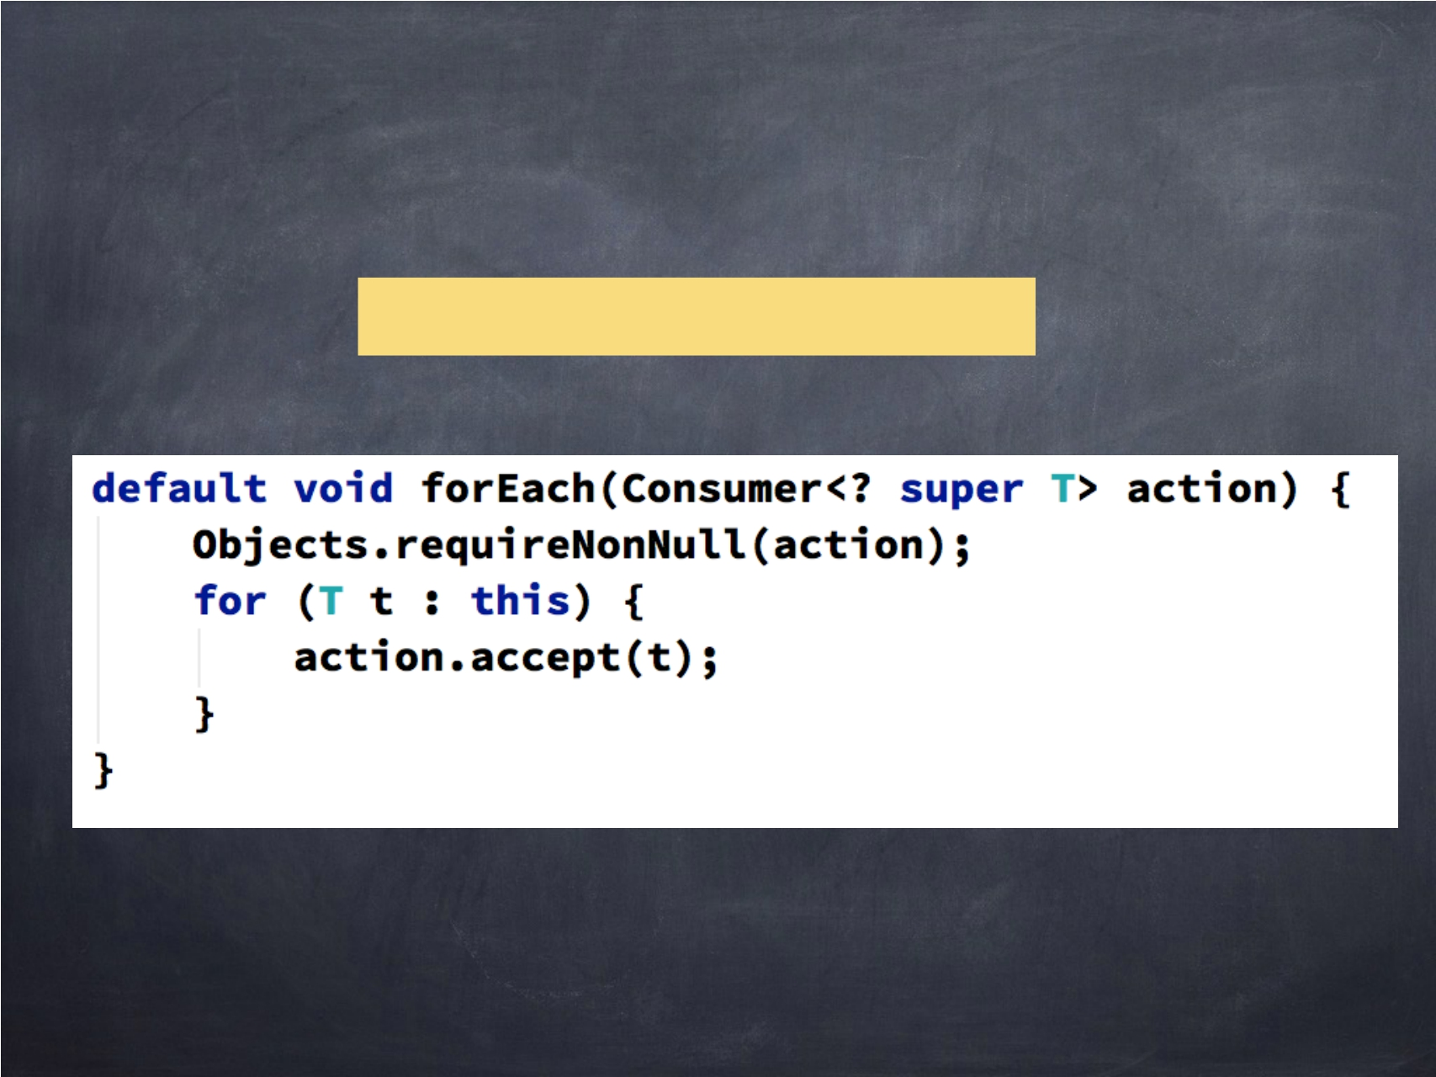
Example of default method
Iterable’s forEach method
11

Slide 12
Let’s write a simple Calculator
Calculator >> Interface BasicCalculator >> Implementation
12

Slide 13

Multiple inheritance
接口有定义方法的能力, 我们可以拥有多种行为的接口
13

Slide 14
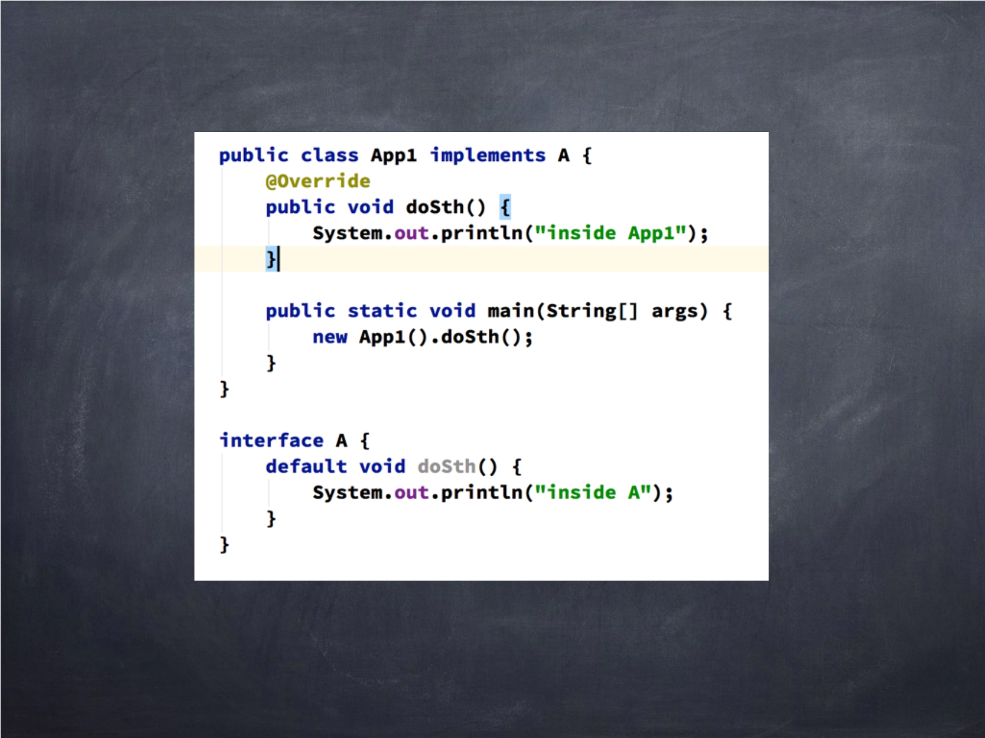
Interface Class Hierarchy
14

Slide 15
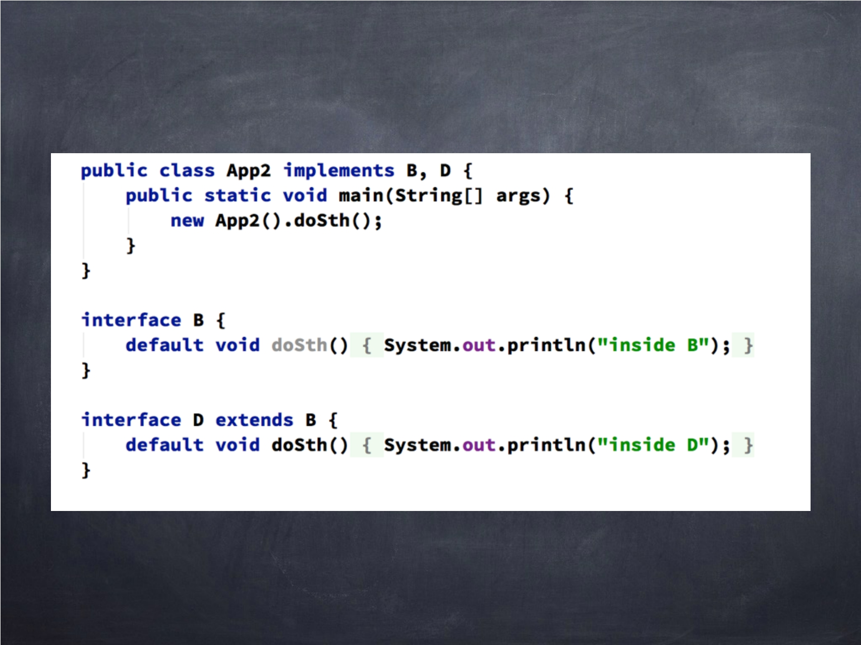
Multiple Interface Hierarchy
15

Slide 16
Section 02
Functional Paradigm
16

Slide 17
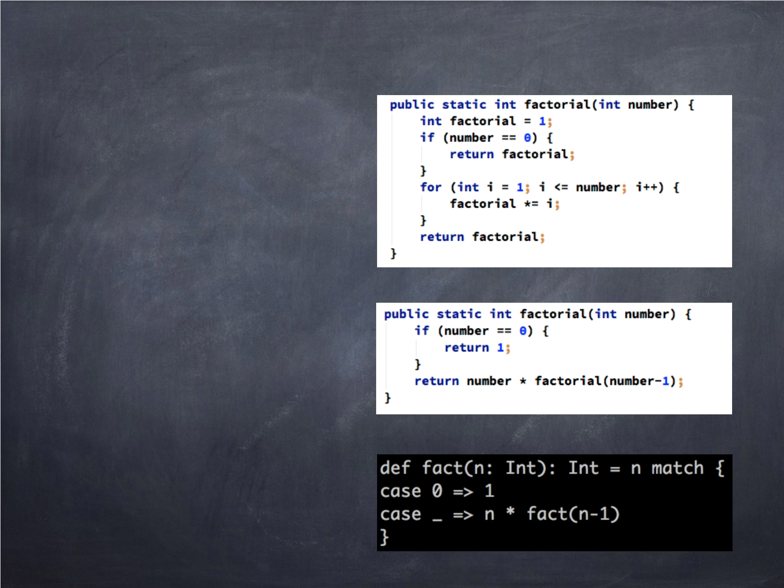
Canonical example — Factorial
命令式 >>
响应式>>
Scala >>

Slide 18

Functional programming
“Functional programming is so called because a program consists entirely of functions.”
- John Hughes, Why Functional Programming Matters
18

Slide 19
What is a function?
一种副作用的自由计算，当以相同的参数传递时，总是产生相同的值。
19

Slide 20

Why should we embrace functional
programming?
函数式程序更简单
无副作用
更少的并发问题
20

Slide 21

Functional Languages
Haskell ML Erlang
F# - (Hybrid) Scala - (Hybrid) Clojure
Java 8 - (Hybrid)
21

Slide 22

Key Functional Programming Concepts
Function
一种副作用的自由计算，当以相同的参数传递时，总是产生相同的值。
高阶函数
将函数作为参数或返回函数的函数。
引用透明
允许您用其值替换函数
递归
函数调用本身
延迟计算
直到需要时才计算函数
22

Slide 23
SECTION 03
LAMBDAS
23

Slide 24
Demo >> lambda
Example_Lambda 1
24

Slide 25
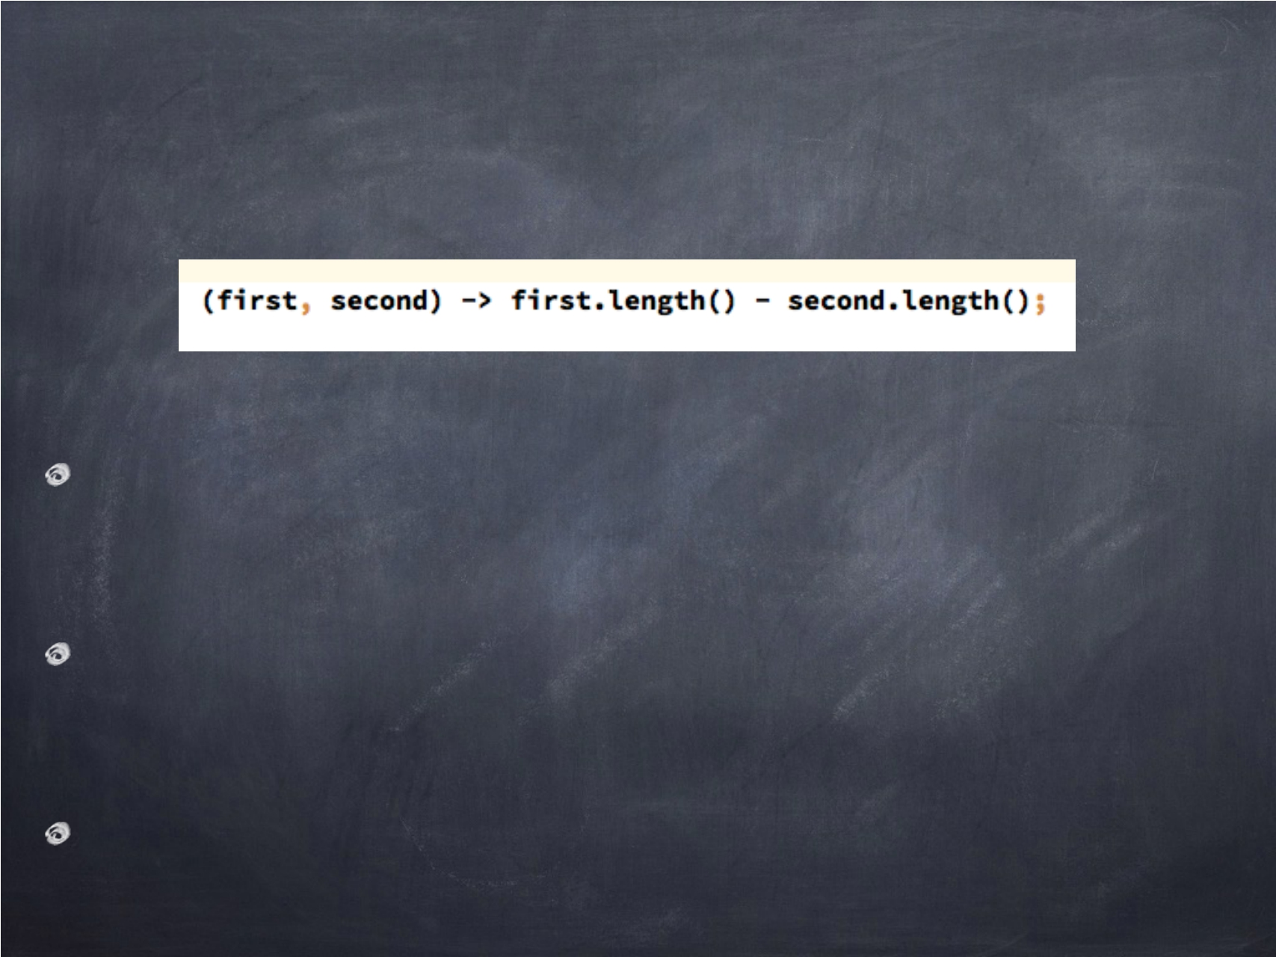
Lambda expression
The (first, second) are parameters of the
compare method
first.length() - second.length() is the function body
-> is the lambda operator
25

Slide 26
Lambda syntax
- (String a, String b) -> {return a + b;}
- (a,b) -> a + b
- a -> a*a
- () -> a
-
() -> {System.out.println(“hello world”);}
26

Slide 27
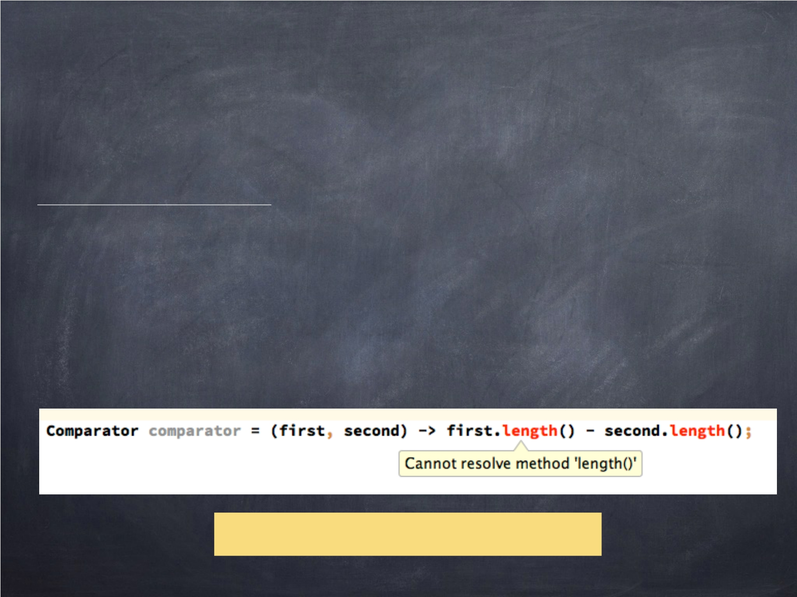
Type Inference
从上下文推断类型的行为称为
类型推断
在大多数情况下，javac将从上下文推断类型。
如果不能解析，编译器将抛出一个错误。
Demo >> Example2_Lambda
27

Slide 28
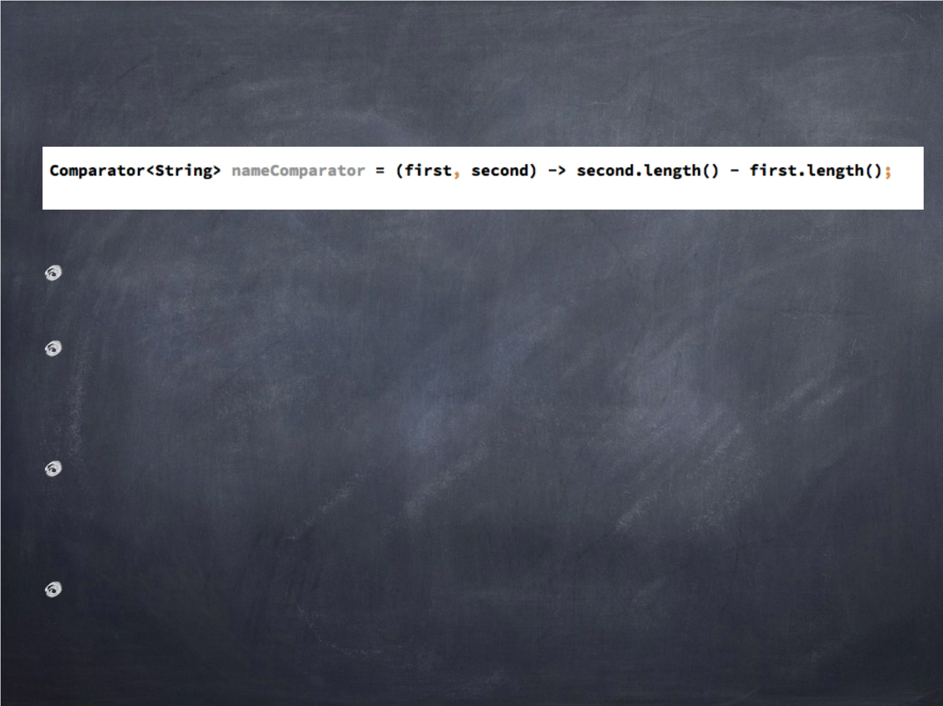
Lambdas are Typed
lambda表达式的类型是一个接口
只有使用具体单个抽象方法的接口
这些接口统称函数式接口
可以使用@FunctionalInterface注释将接口标记为函数接口
28

Slide 29
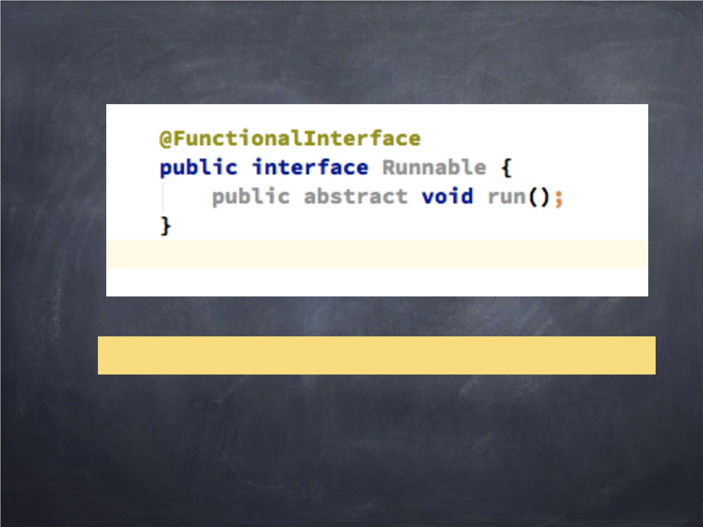
Example @FuntionalInterface
Demo >> Example3_Functionalnterfaces.java
29

Slide 30
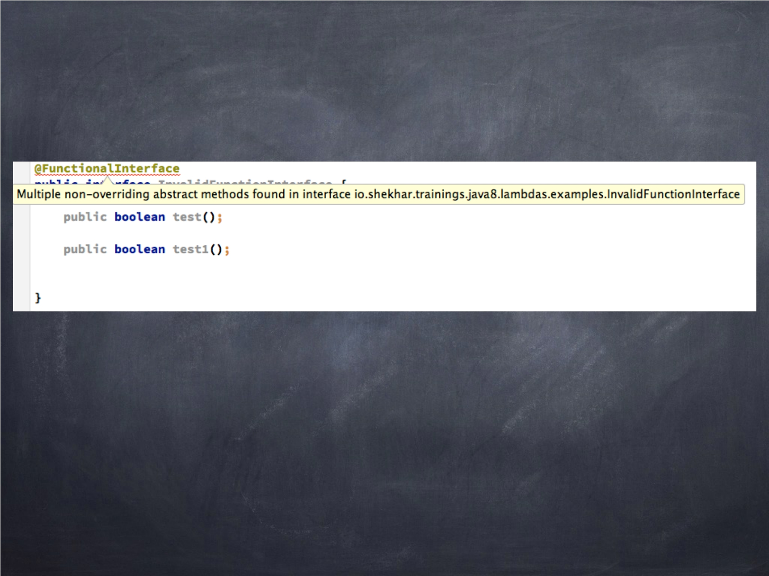
Invalid @FunctionalInterface
30

Slide 31
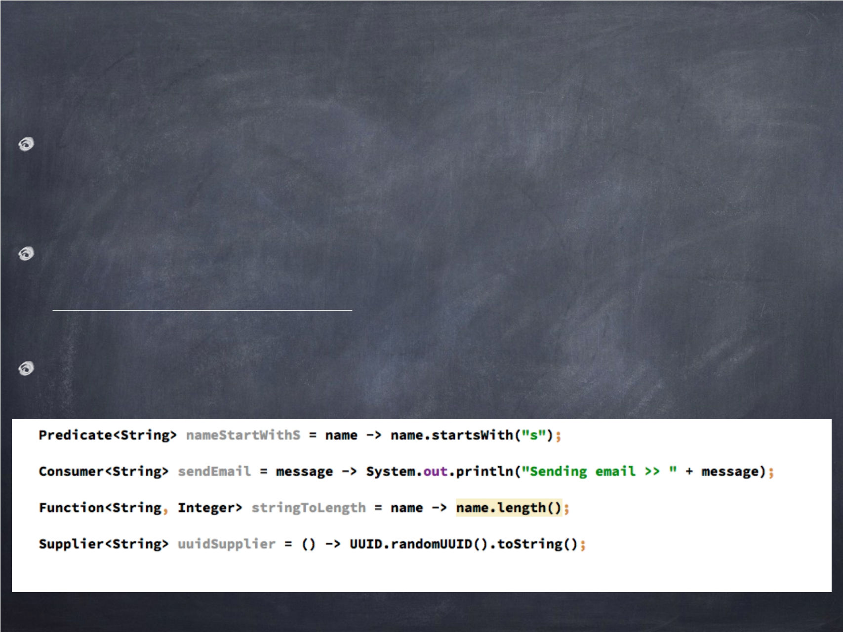
Look at few @FunctionalInterface
Most of the time you don’t have to write your own @FunctionalInterface
You can leverage interfaces defined in java.util.function package
Some shown below:
31

Slide 32
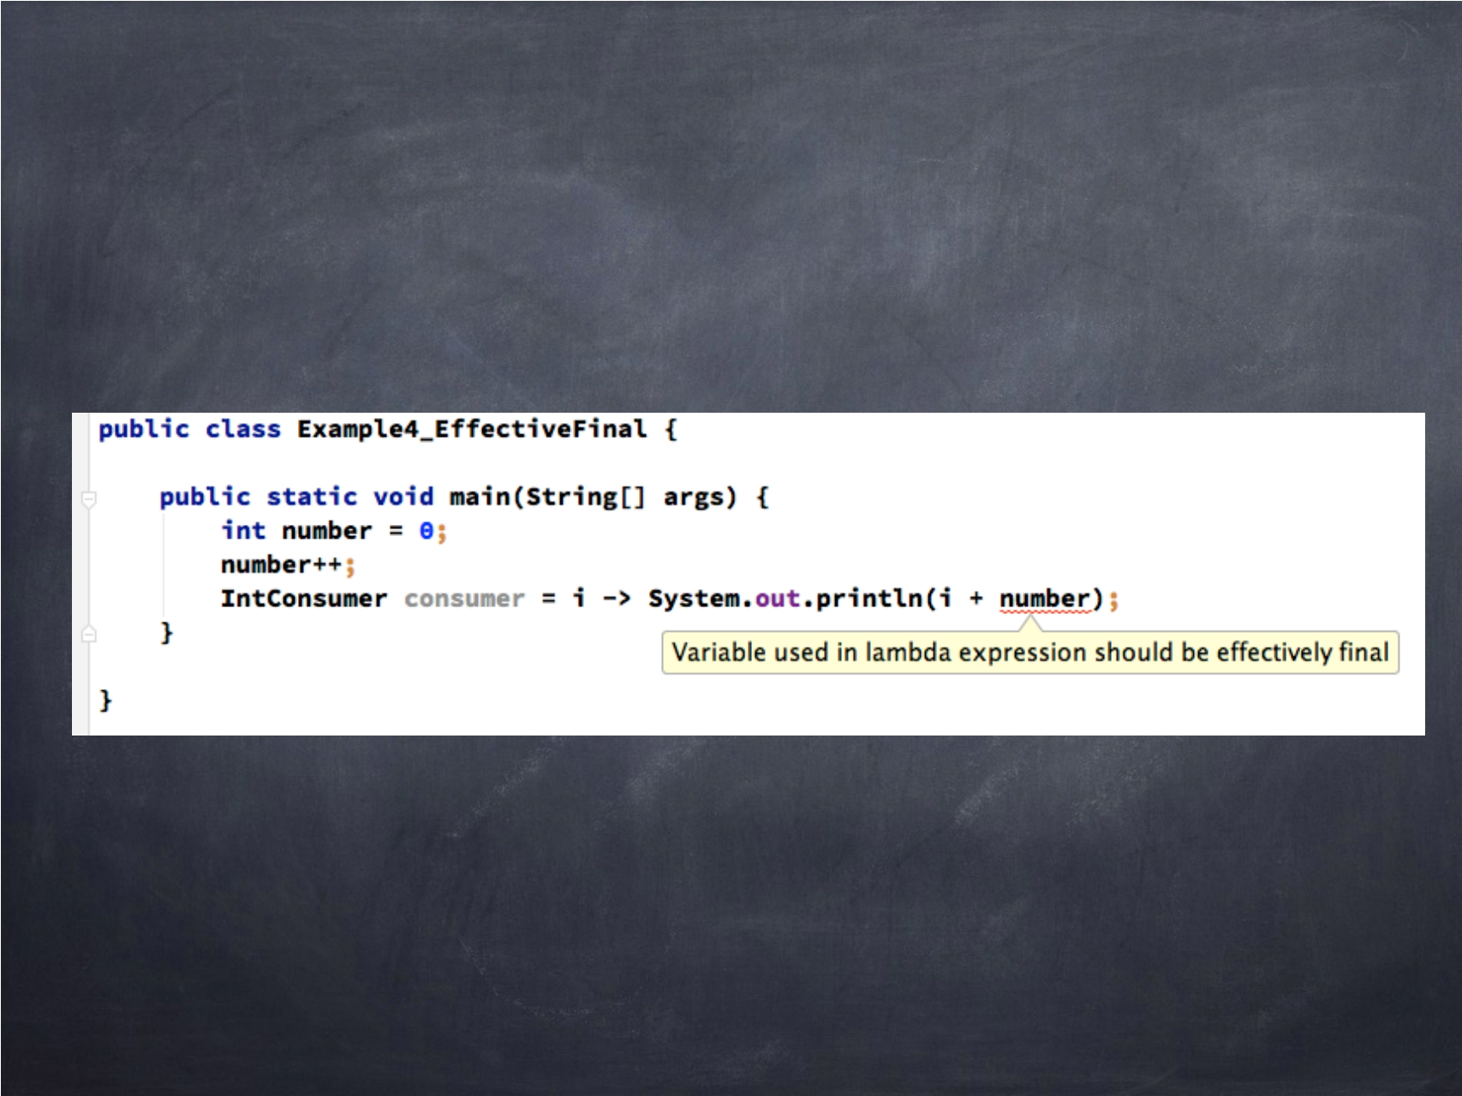
Using local variables >> Effective final
32

Slide 33
Method References
33

Slide 34

Method reference
允许您从现有方法实现创建lambda表达式
lambda只调用特定方法的简写
String str -> str.length()
String::length
34

Slide 35
Demo >>
Method Reference
35

Slide 36
SECTION 04
STREAM PROCESSING
36

Slide 37

Stream Processing
Why we need a new data processing abstraction?
Stream vs Collection Using Stream API
37

Slide 38

Why?
集合API版本太旧
开发人员需要更高级别的声明式数据处理API
并行处理数据
38

Slide 39
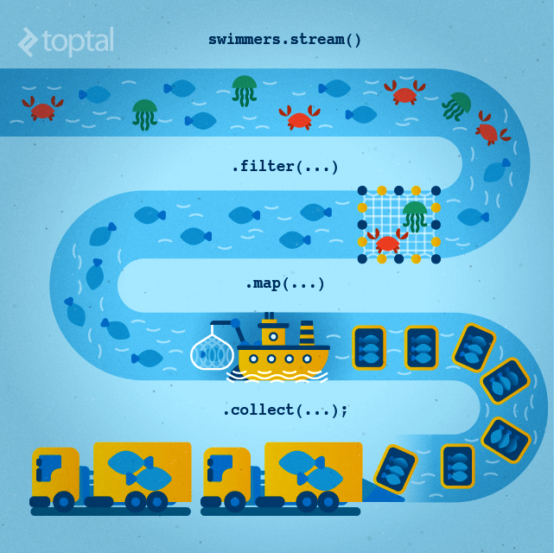

Slide 40
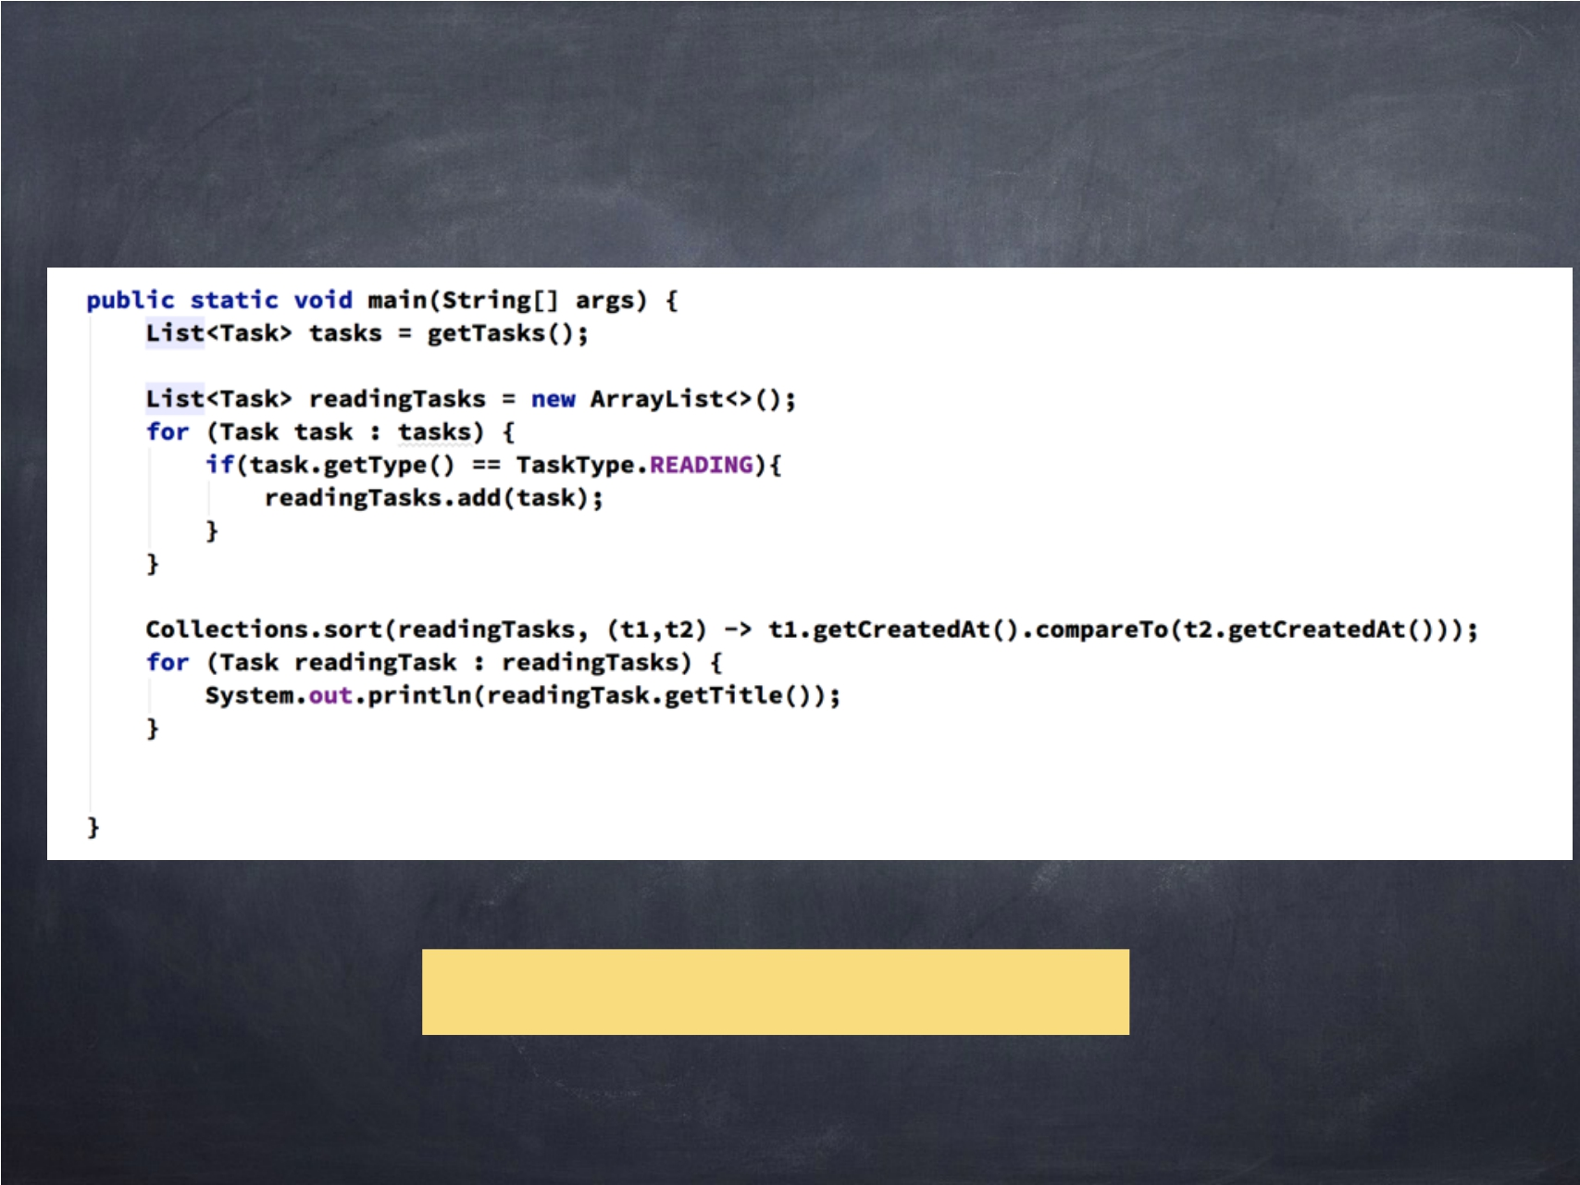
Data processing before Java 8
What does this code do?
40

Slide 41
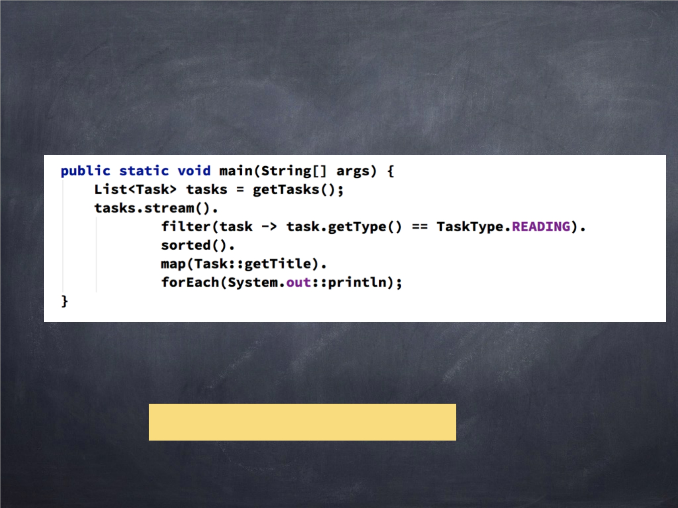
Data processing in Java 8
Isn’t this code beautiful?
41

Slide 42
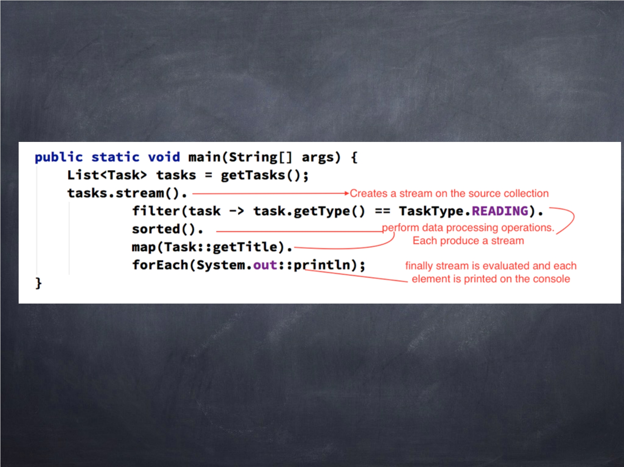
Understanding the code
42

Slide 43

Stream
Stream是来自支持数据处理操作的源的元素序列
source -> collection with elements
data processing operations -> filter, map, etc.
43

Slide 44
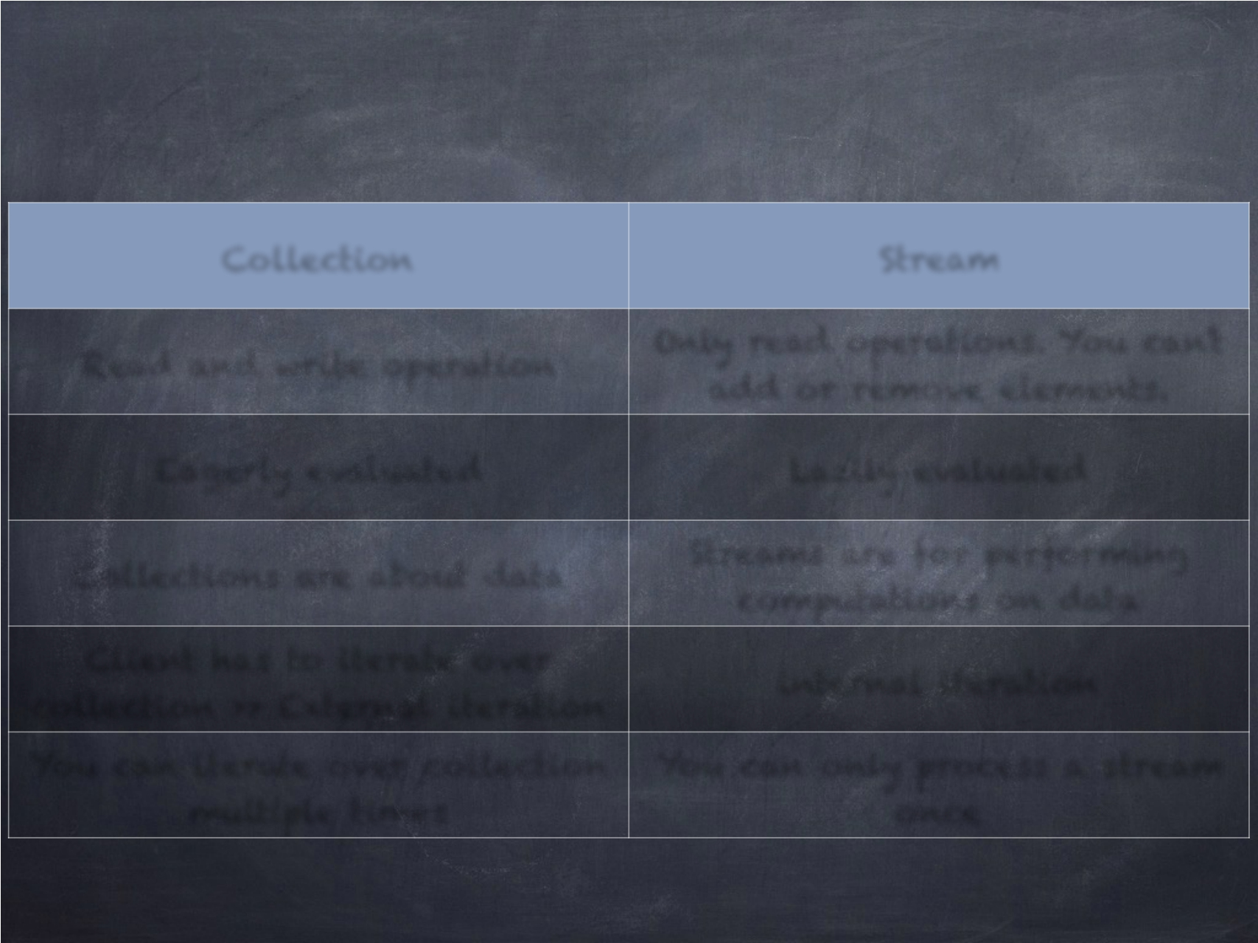
Collection vs Stream
Collection Stream
Only read operations. You can’t
add or remove elements.
Read and write operation
Eagerly evaluated Lazily evaluated
Client has to iterate over
collection >> External iteration
internal iteration
You can iterate over collection
multiple times
You can only process a stream
once
44

Slide 45
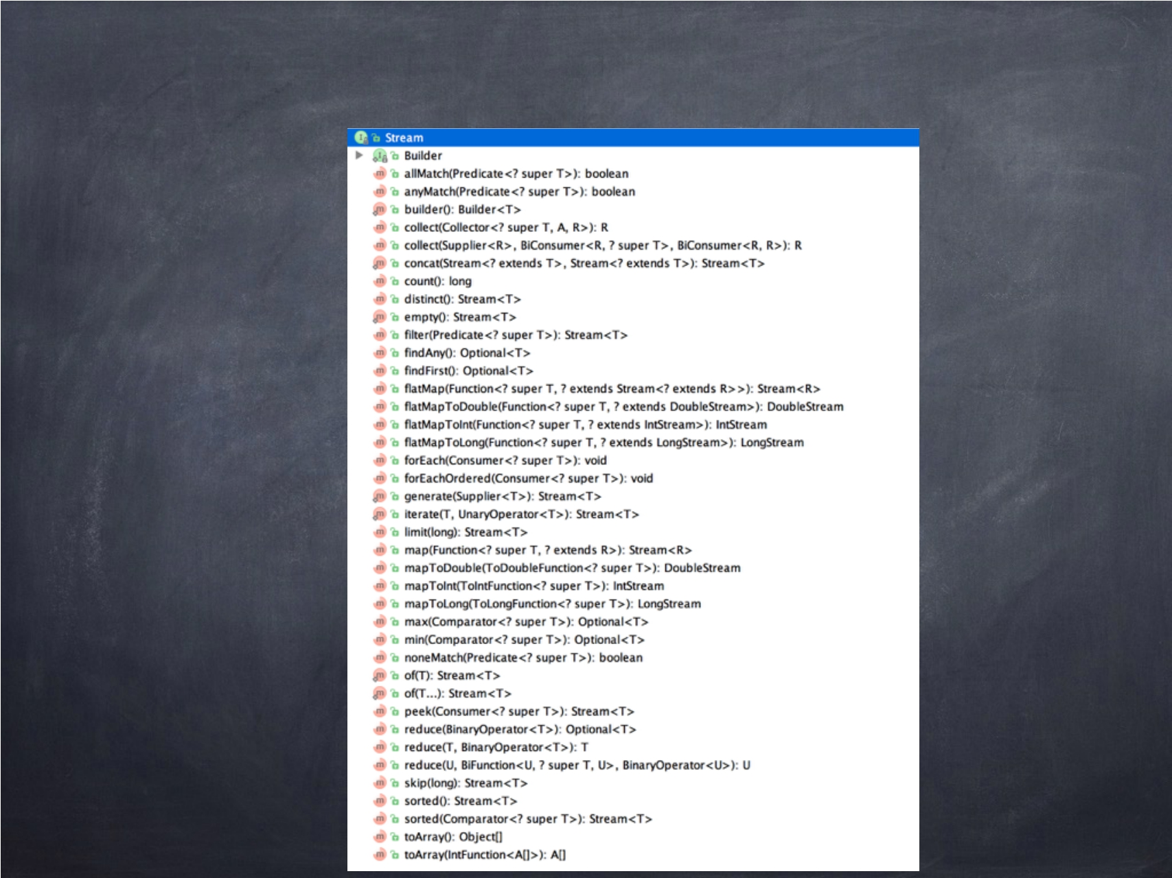
Stream API
60

Slide 46

Stream operations
Intermediate operations >> which results in another stream
map, filter, sort, distinct, etc
Terminal operations >> which produce a non-stream result
collect, foreach,
46

Slide 47
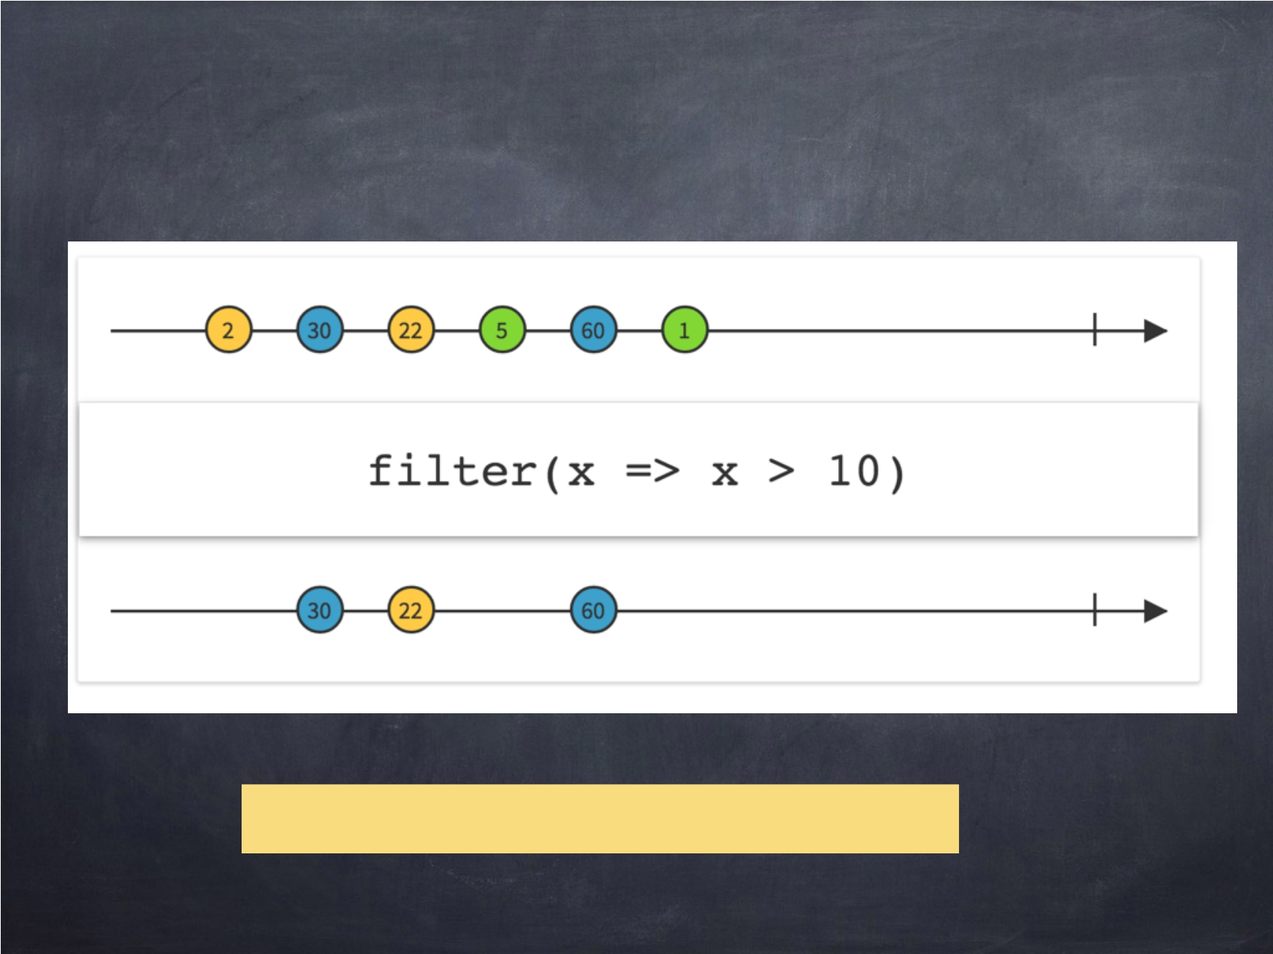
filtering
47

Slide 48
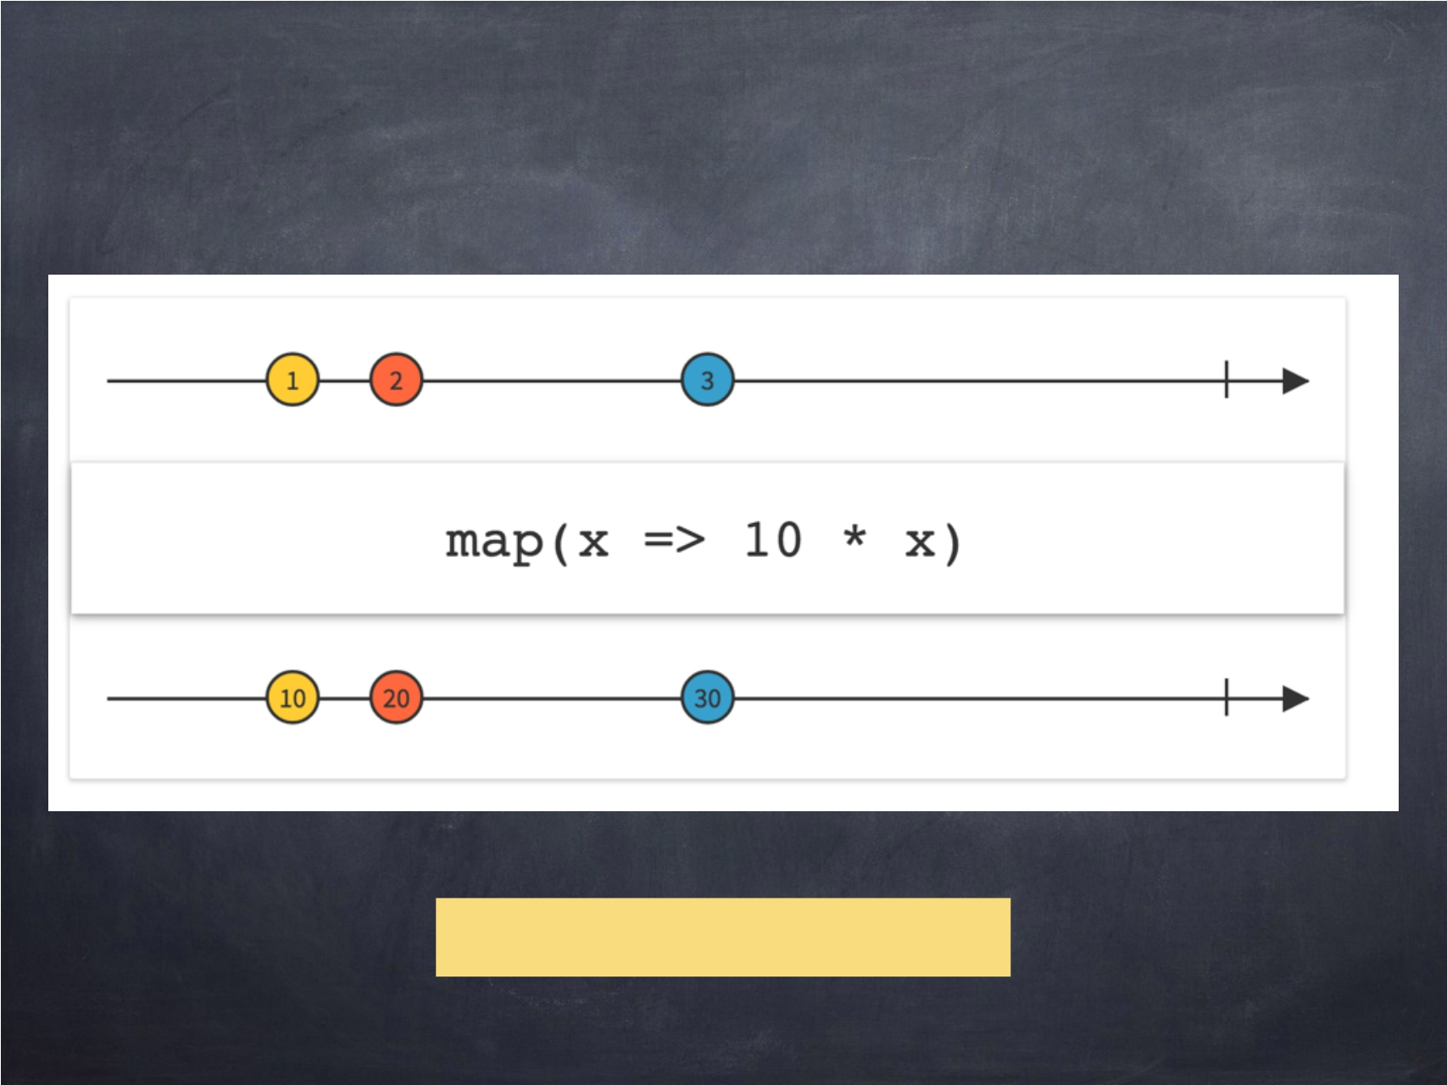
map operation
Example3_MapStreams
48

Slide 49
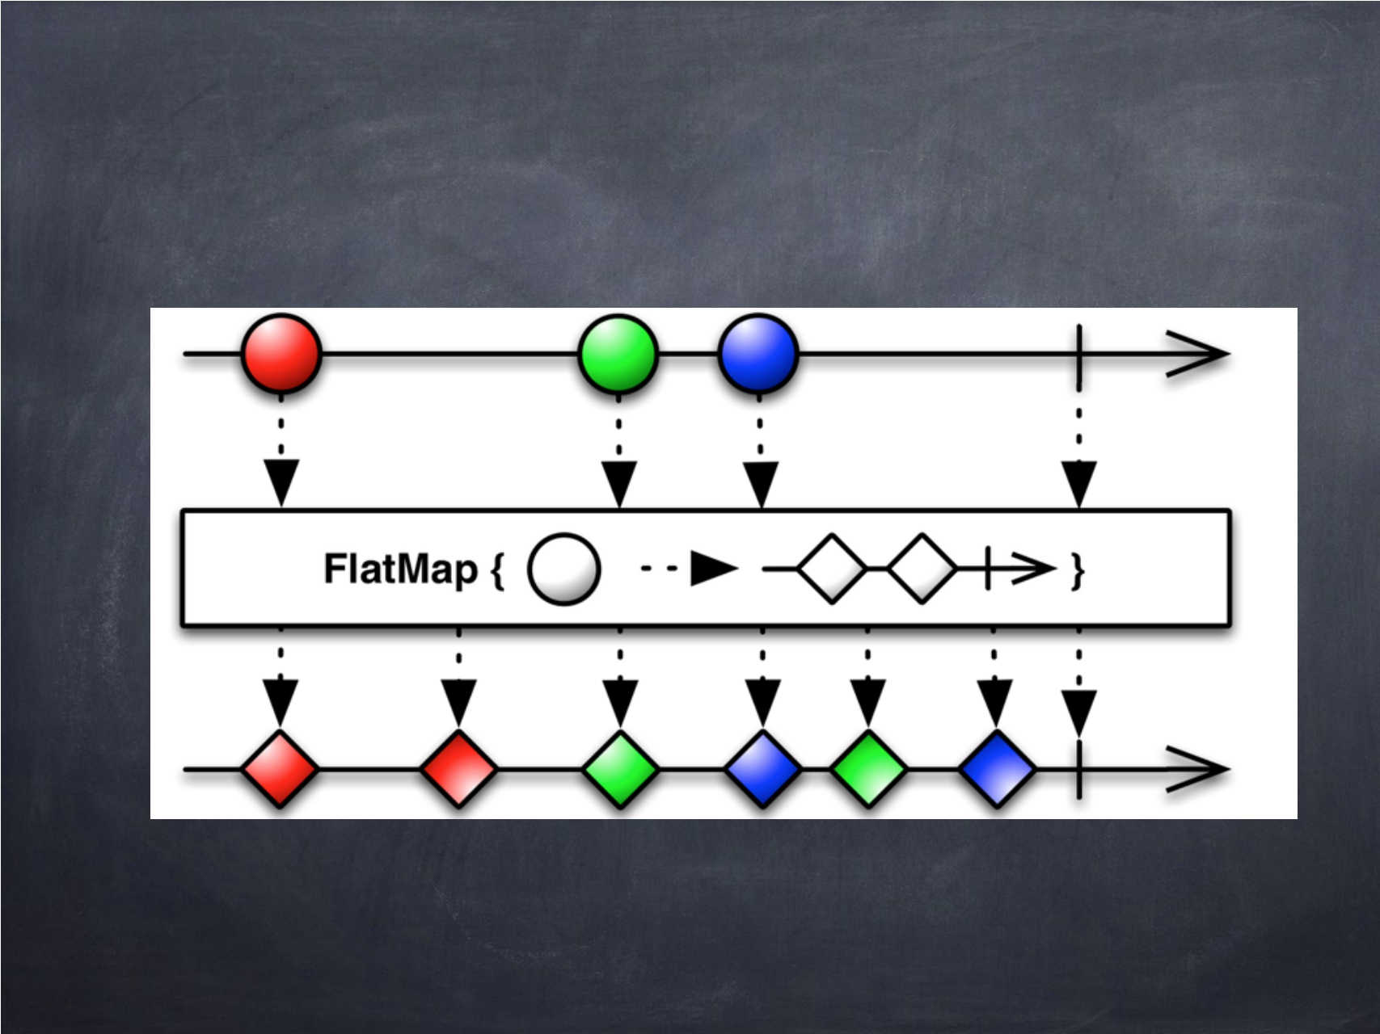
flatmap operation
49

Slide 50
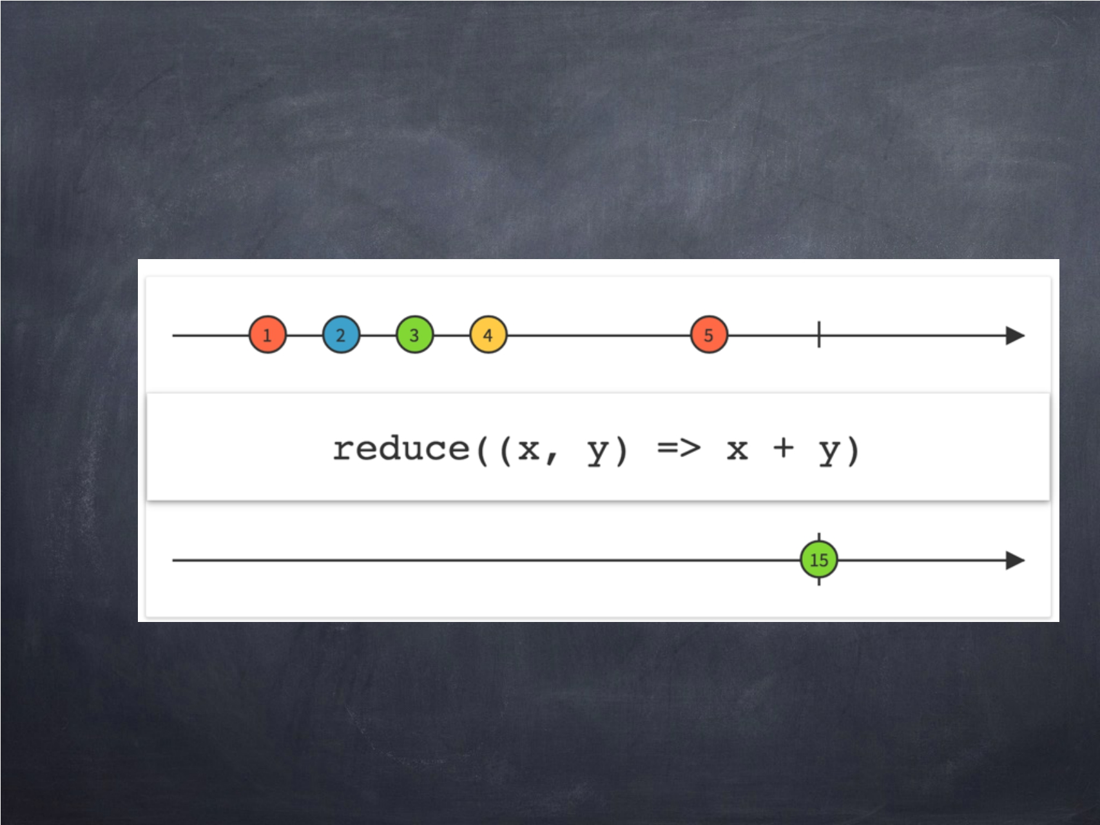
reduce operation
50

Slide 51
Working with numeric streams
IntStream LongStream DoubleStream
51

Slide 52

Parallel Stream
您可以通过调用并行操作符来创建并行流的实例
52

Slide 53
SECTION 05
COLLECTORS
53

Slide 54
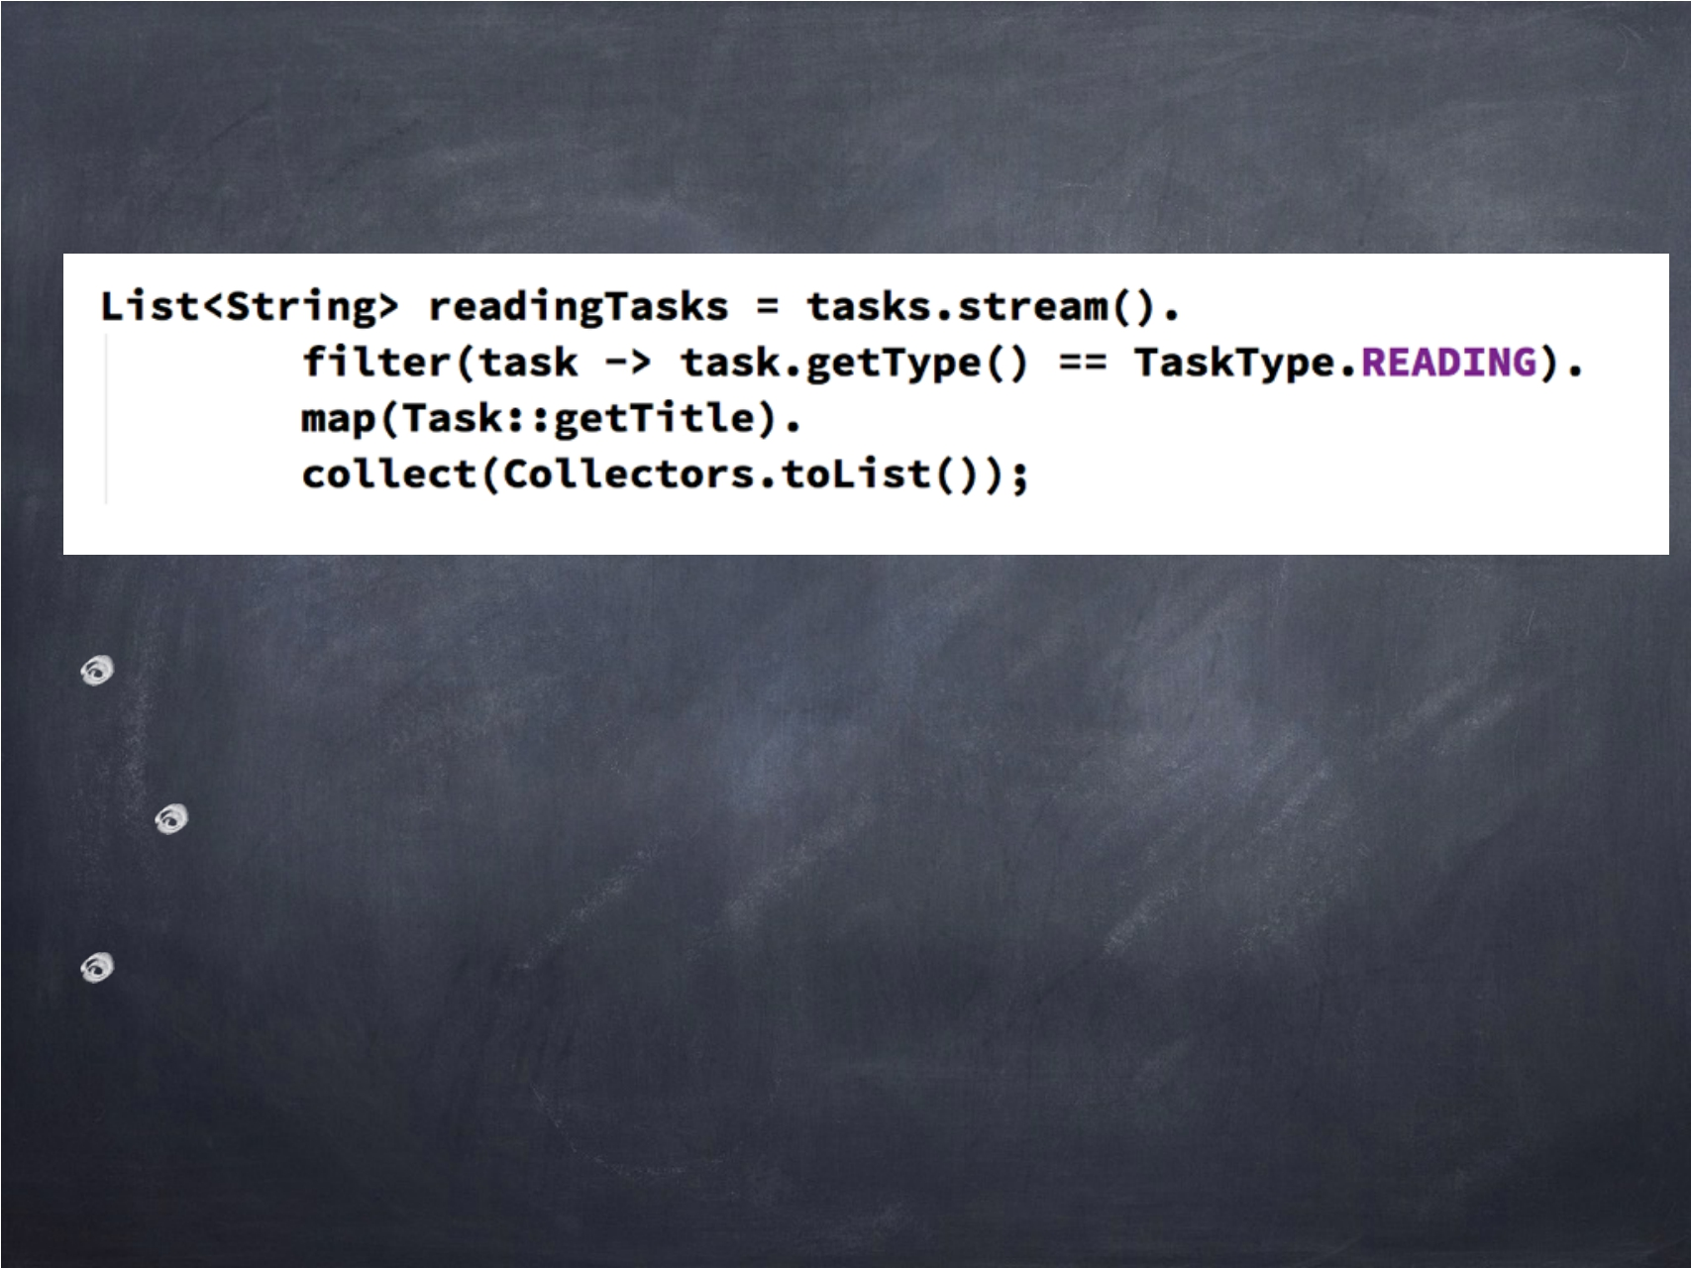
Collector
Reduce a stream to a single value
collect is a reduction operation
They are used with collect terminal method
54

Slide 55
What you can do with collect?
Reducing stream to a single value Group elements in a stream Partition elements in a stream
55

Slide 56

Collectors class
包含用于大多数常见收集器的静态工厂方法的实用程序类
that collect to a Collection
grouping
partitioning
56

Slide 57

Grouping elements
按键分组元素
您可以同时进行单级和多级分组
Demo >> Example3
57

Slide 58
Sec 06
Optional<T>
58

Slide 59
How many of you
have experienced
NullPointerException?
59

Slide 60
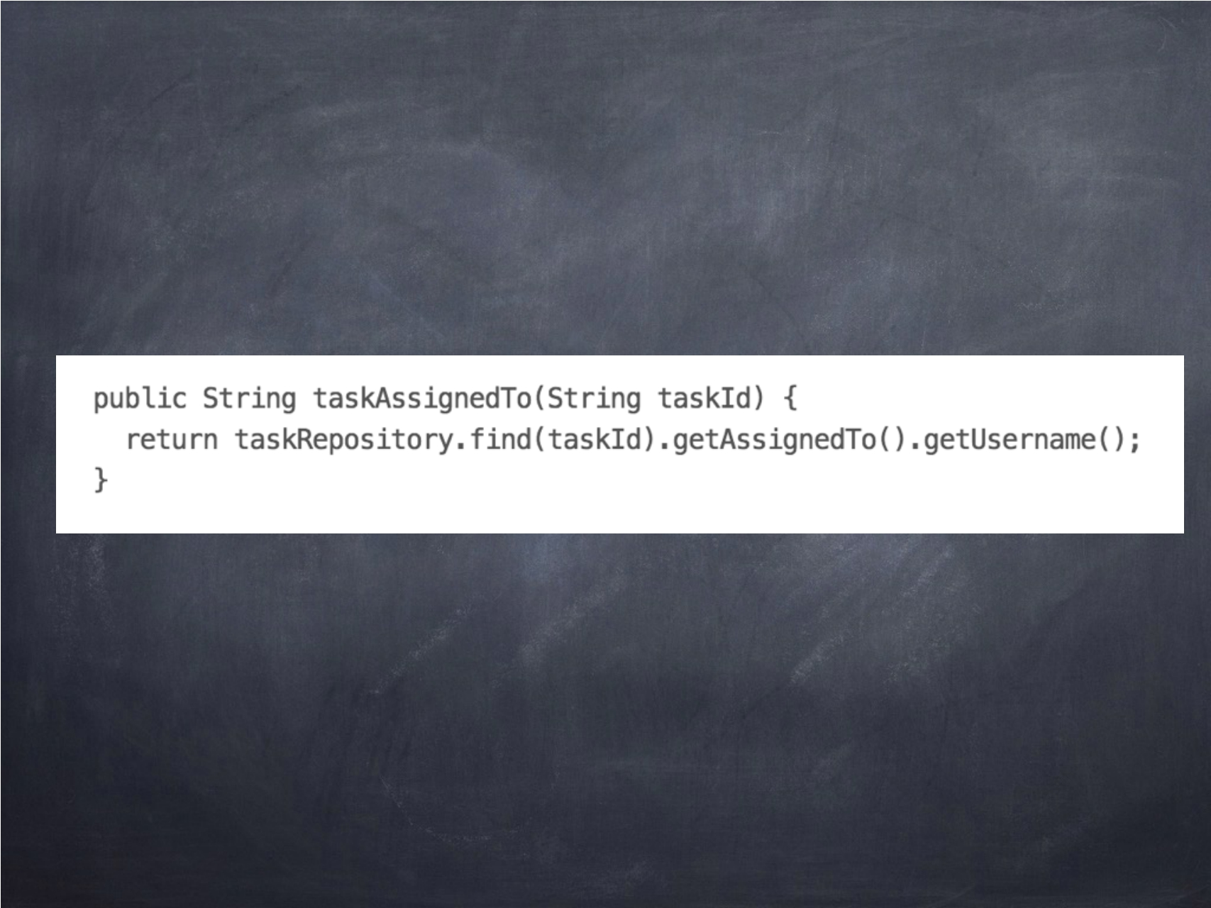
What could possibly go wrong?
60

Slide 61
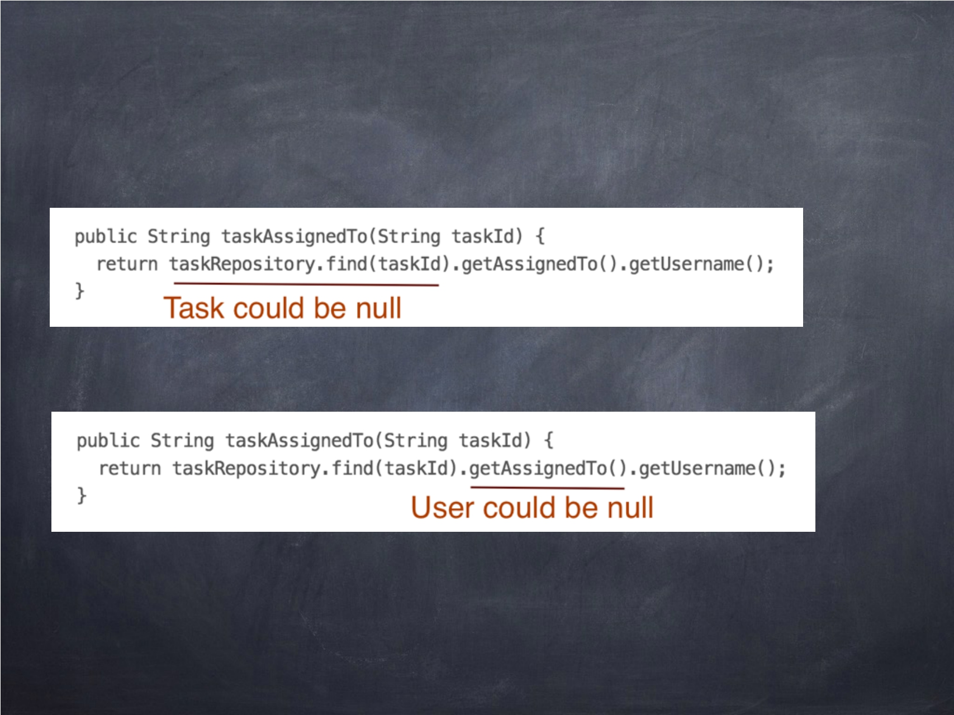
NullPointerException
61

Slide 62
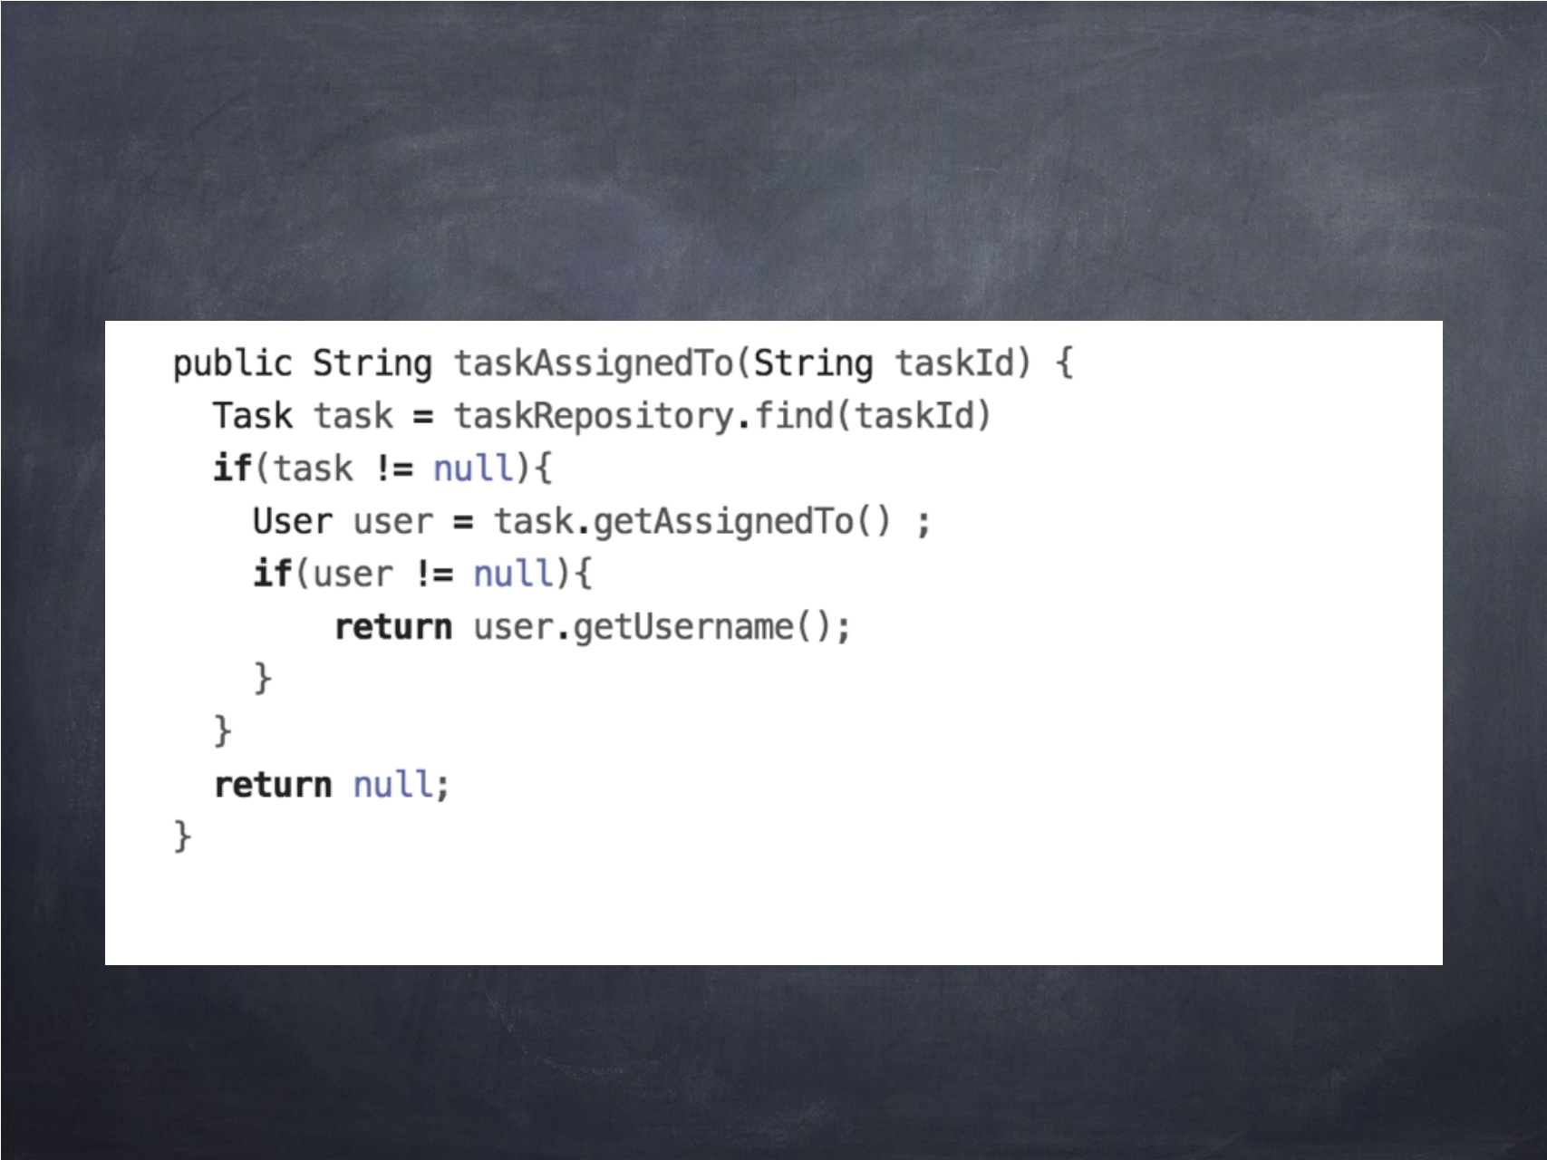
We end up writing …
62

Slide 63
Biggest problem with code
空值在API设计中不可见
63

Slide 64
Possible solutions
Null Object Pattern << Before Java 8 Optional << From Java 8
64

Slide 65

Optional
一个容器，可以包含值，也可以不包含值
如果一个函数返回可选的，那么客户端将知道该值可能不存在
常见的概念是函数式语言
MayBe, Nothing >> Haskell Option, Some, None >> Scala Optional<T> >> Java 8
65

Slide 66
Demo >>
Optional TaskRepository
66

Slide 67
SECTION 07
DATE AND TIME API
67

Slide 68

Thanks
68

